Slide 1
Orbital Sight
AI-powered Orbital Debris Visualization, Clustering & Risk Prediction
Team: MindFirst | Hackathon: ASTRA 2025, DTU

Slide 2
Problem Statement
Growing challenge: Increasing orbital debris (Starlink, defunct satellites, rocket bodies).
Risks: Collisions → damage to satellites, ISS crew safety, Kessler Syndrome.
Need for real-time visualization & prediction for SSA (Space Situational Awareness).

Slide 3
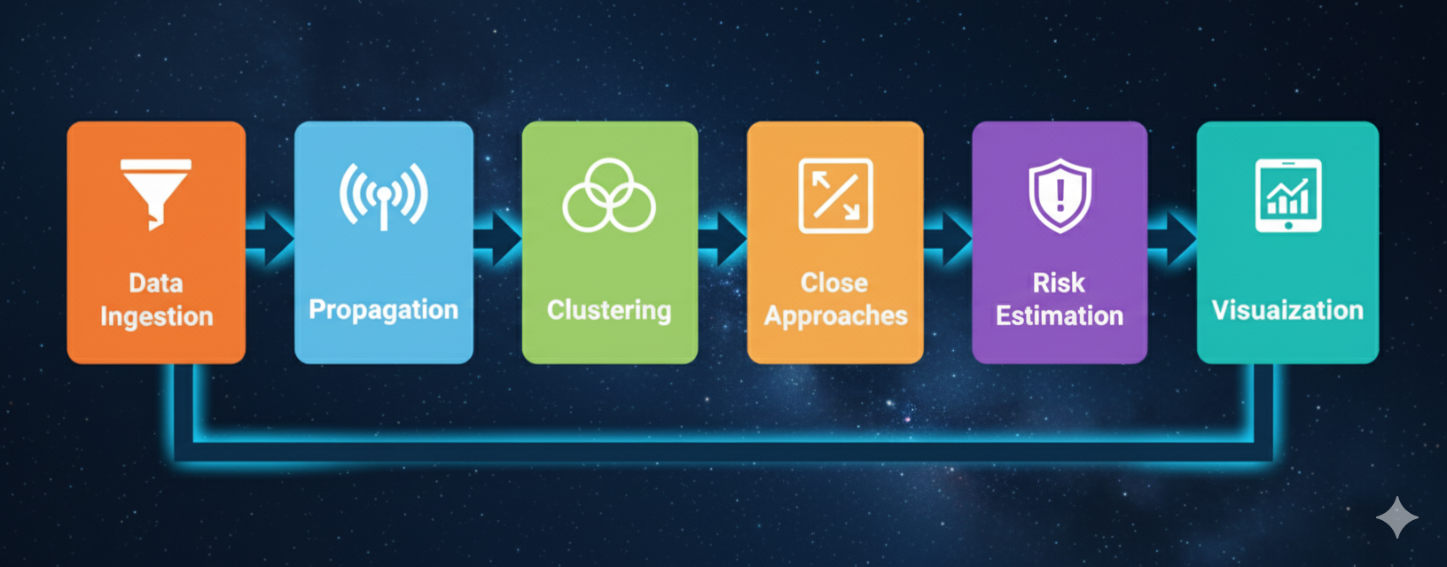
Methodology
Flow diagram:
TLE Ingestion (CelesTrak / fallback)
Orbit Propagation (SGP4)
Clustering (DBSCAN in ECI space)
Close Approach Detection (KDTree)
Risk Estimation (distance + velocity → risk score)
Visualization (Dash Dashboard + Plotly)

Slide 4
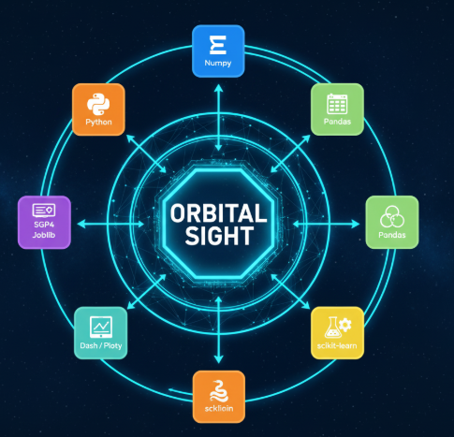
Implementation
Core Features:
Parallel orbit propagation
DBSCAN clustering snapshots
Logistic-based risk formula
Risk heatmaps & trend forecasting
Interactive dashboard with multiple views

Slide 5
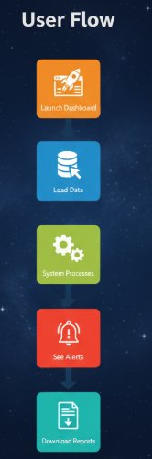
How OrbitalSight Works
User Flow:
Launch Dashboard → User opens OrbitalSight interactive interface.
Load Data → TLEs fetched from CelesTrak or fallback dataset.
System Processes → Propagation, clustering (DBSCAN), close-approach detection (KDTree)..
See Alerts → Predictive alerts highlight high-risk conjunctions.
Download Reports → Export CSV reports for further analysis

Slide 6
Results
🌍 Risk zones mapped on globe (weighted heatmaps)
🟢 Clusters identified → helps prioritize monitoring
🚨 Successful detection of close approaches in 24h prediction window
📊 Dashboard enables intuitive exploration + CSV reports

Slide 7
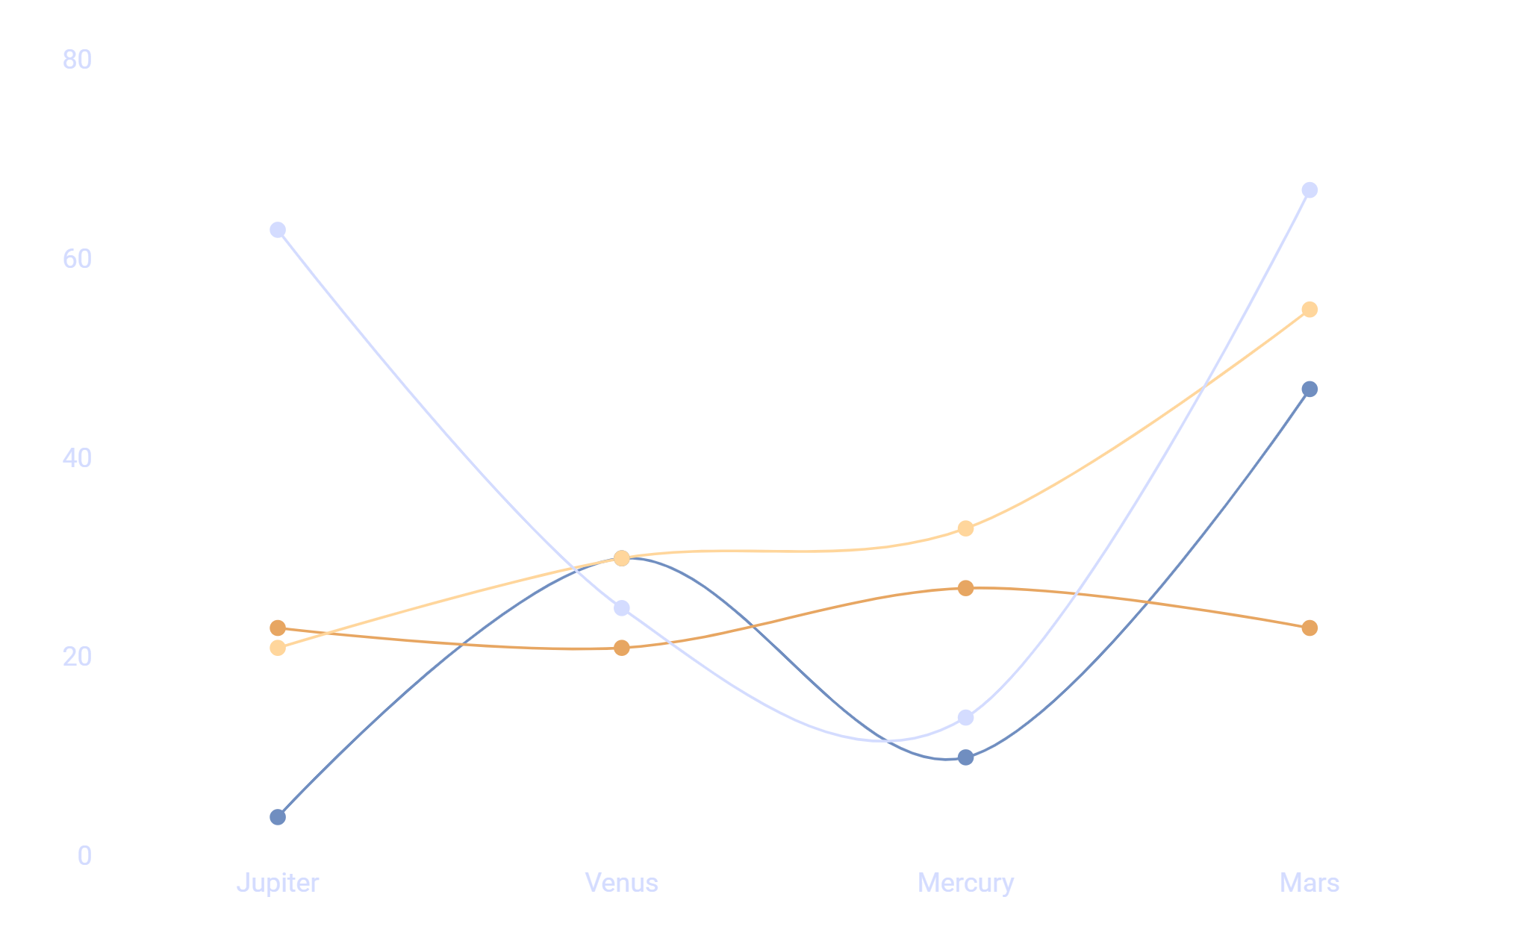
Innovation & Scalability
💡 Innovation: Clustering + KDTree risk detection + predictive analytics
⚙️ Feasibility: Uses existing TLEs, scalable with cloud compute
🚀 Scalability: Extendable to 10k+ objects with GPU/parallel backends

Slide 8
Future Scope
.
🌍 Integration with ISRO/NASA SSA systems
🤖 LSTM/Transformers for trajectory forecasting
📈 Collision probability estimation with covariance data
👨‍🚀 Crew safety extensions for human spaceflight

Slide 9
Conclusion
OrbitalSight provides:
🔴 Real-time awareness of debris risks
🟡 Data-driven prioritization of high-risk clusters
🟢 Scalable platform for future SSA applications
✨ OrbitalSight – Turning space debris chaos into clarity

Slide 10

Acknowledgment
Built at ASTRA Hackathon 2025 | DTU
Team: MindFirst
🔧 Built with ❤️ in 8 hours
🙌 Thanks to ASTRA Hackathon organizers & mentors
🖥️ Tech Stack: Python, Dash, Plotly, sgp4, scikit-learn
Thankyou

